Slide 1
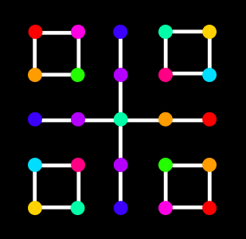
Dots And Boxes
CPCS331 – Artificial Intelligence – Spring2020 -Project I
[ implementing dots and boxes Using Alpha Beta,
Minimax and MCTS algorithms]

Slide 2
Dots and Boxes
Dots and Boxes is a two player game, whereas the players draw a rectangular grid of dots typically with size 6*6 and take turns drawing lines between pairs of horizontally or vertically adjacent dots, when a plyer form a box he/she gets to play a second turn. The player with the greater number of boxes wins the game.

Slide 3
Problem formulation
1. Initial state
The game starts with an empty 6x6 dots matrix or it
can be at any size.
2. Actions
Connecting adjacent dots either vertically or horizontally in the grid.
3. Transition model
form edges and boxes.
4. Goal test
We reach the goal state if all boxes are formed in the grid. The winner is the one who create more boxes, and if the number of boxes is equal then it is a tie.
5. Path cost function:
Path function is not applicable.

Slide 4
Algorithms used to solve the problem
MiniMax
MiniMax: is a kind of backtracking algorithm that is used in decision making and game theory to find the optimal move for a player.
Alpha-beta pruning
It is an improvement of minimax algorithm. it allows us to take the possible correct values of max and min without having to look at each node in the tree by pruning nodes that are not going to affect the final decision.

Slide 5
Discussion of result

Slide 6
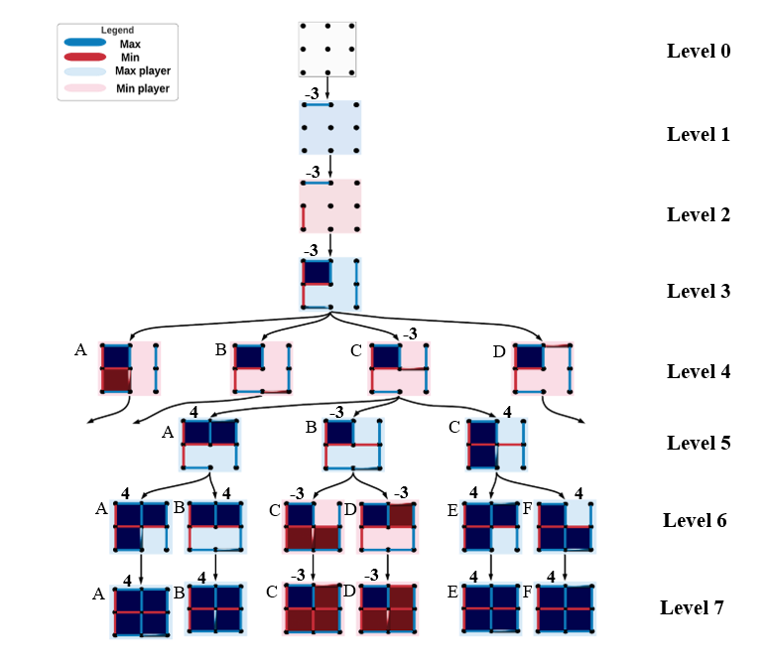
Minimax
Trace

Slide 7
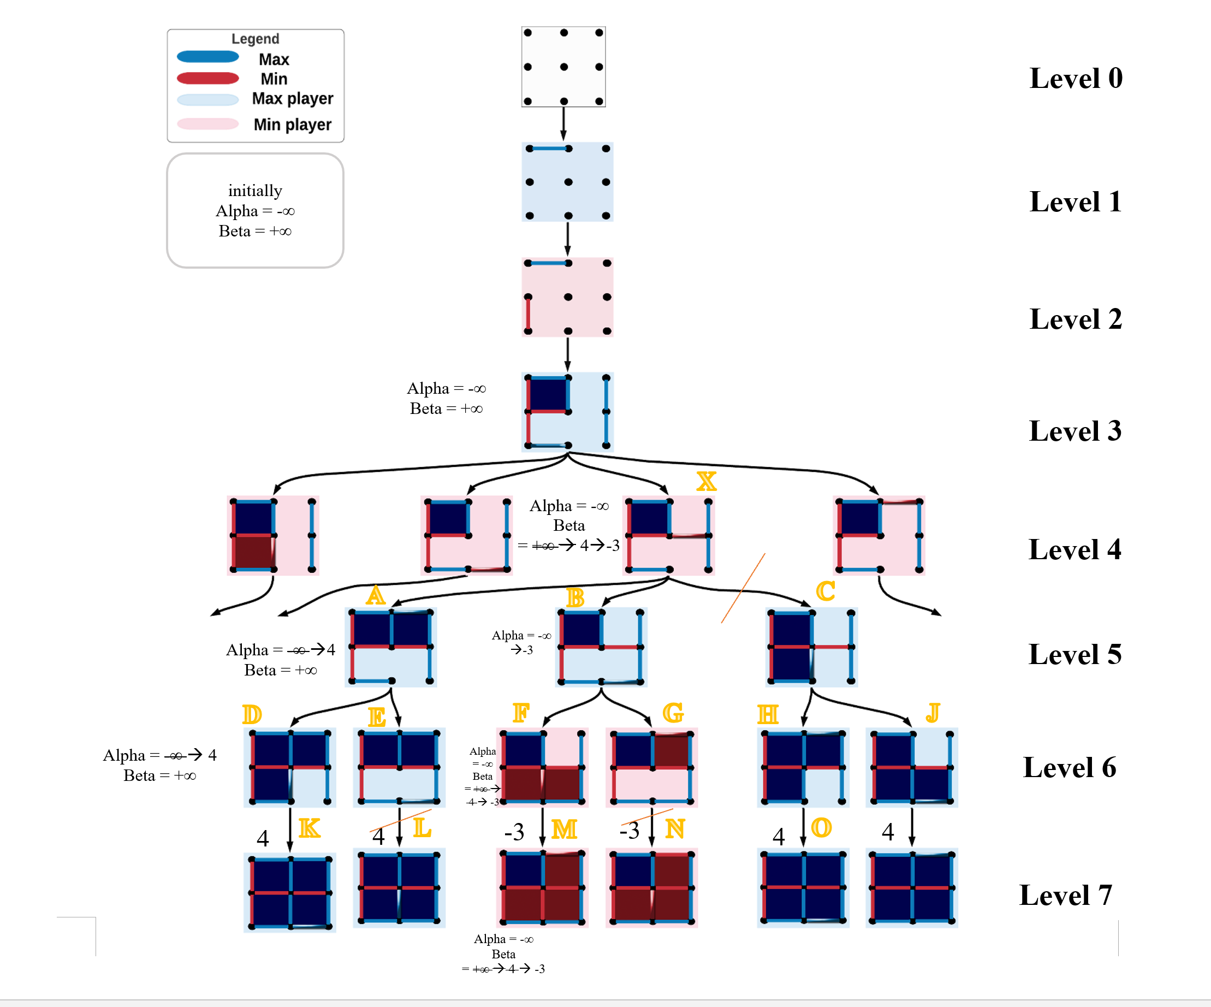
Alpha-beta
pruning
Trace

Slide 8
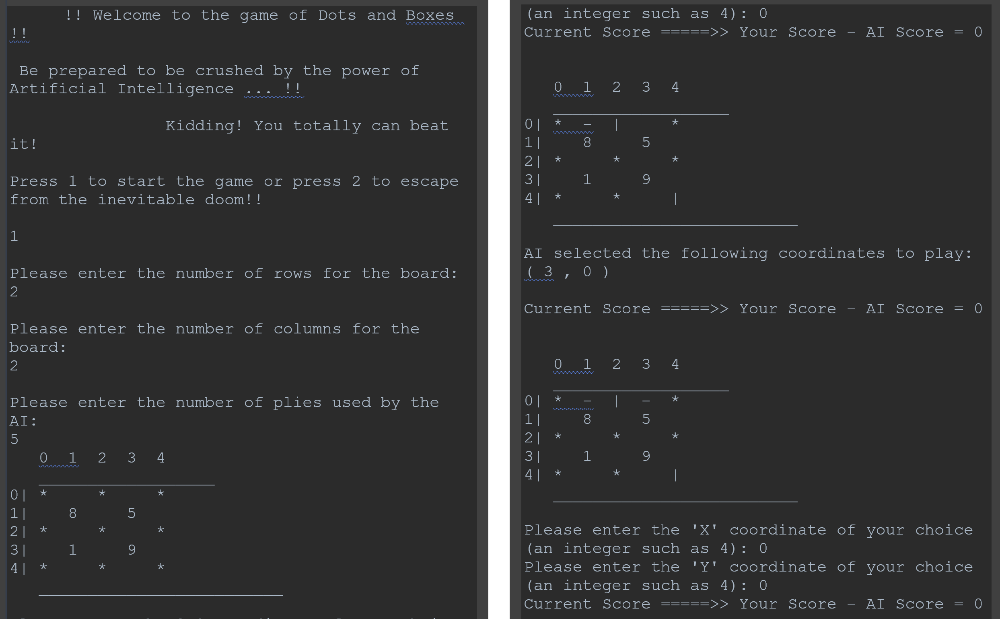
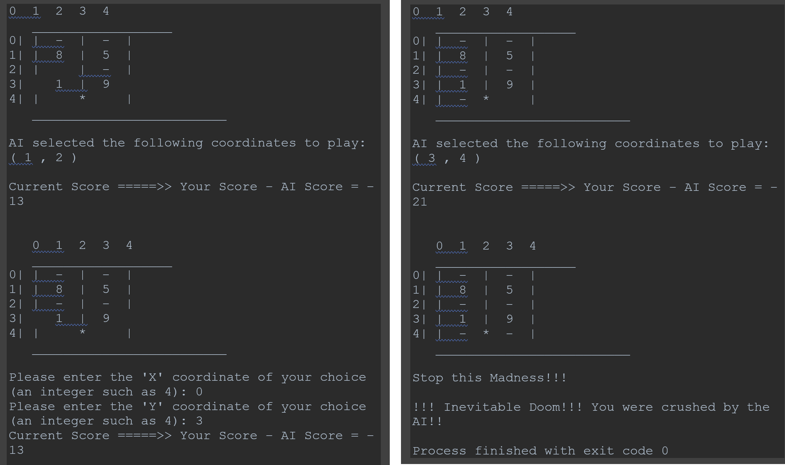
Results

Slide 9
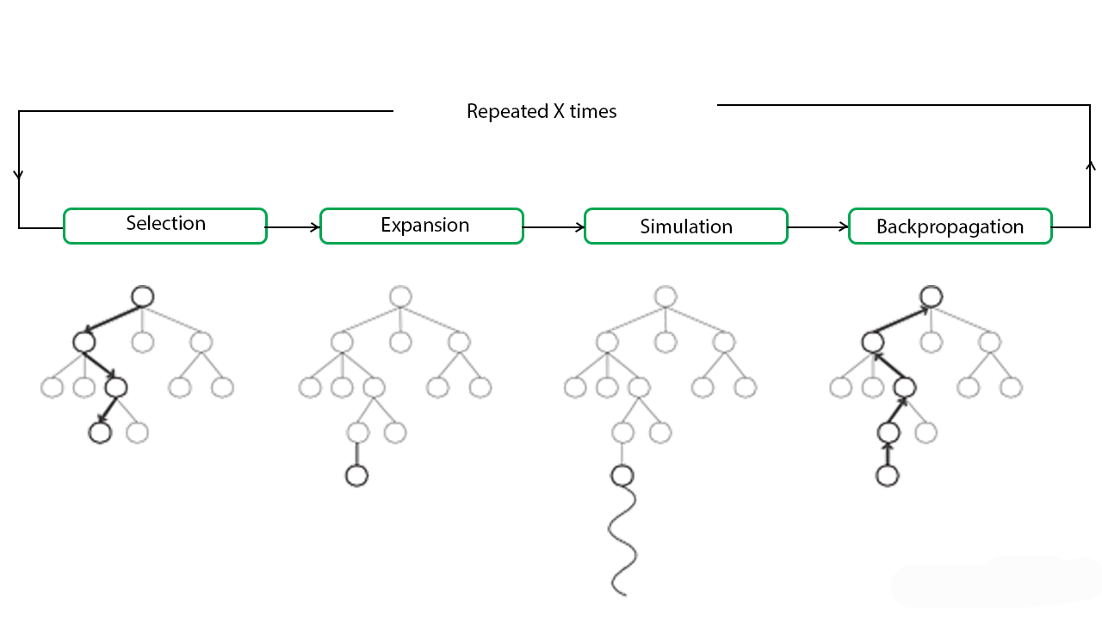
MCTS Algorithm explanation
Monte Carlo algorithm is a tree search algorithm that starts from any state and tries to improve it by producing, its successors and choose the one that is more optimal than the current node and the other successors.
It becomes useful as it continues to evaluate other alternatives periodically during the learning phase by executing them, instead of the current perceived optimal strategy. The process of Monte Carlo Tree Search can be broken down into four distinct steps: selection, expansion, simulation, and backpropagation.

Slide 10
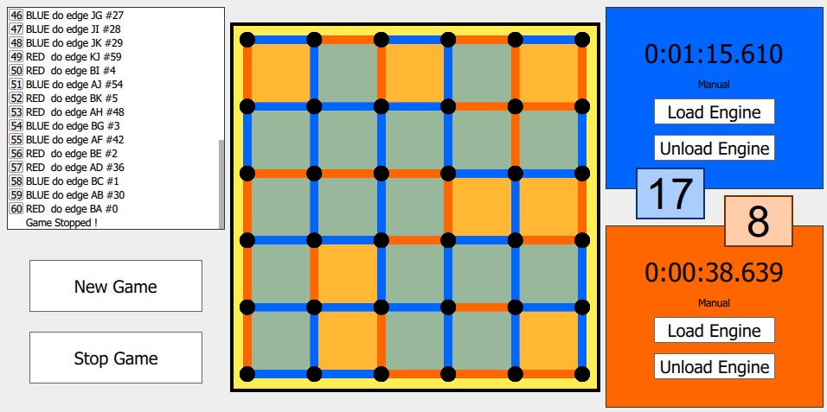
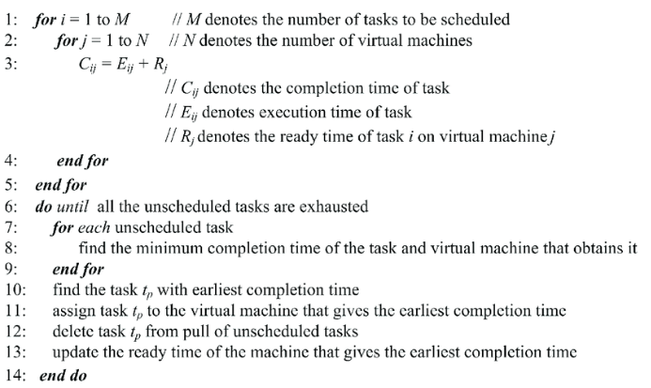
Pseudo Code For
MCT algorithm
</>
Final output

Slide 11
MCTS Algorithm Evaluation
Completeness | optimality | Time complexity | Space complexity
Yes | No, but it finds the optimal solution in only current state | O(mkI/C) where mm is the number of random children to consider per search and kk is the number of parallel searches, and II is the number of iterations and CC is the number of cores available. | O(mk) since in each iteration we map mk states over the cluster.

Slide 12
Thank You
Group
Elham Imdad
Ghadeer Qalas
Lena Abdulmnan
Section AA

